Slide 1

AUTOMATIC CURTAIN OPERATION USING LDR
Group No:12
Group members Reg No:
2110040094
2110040091
2110040076

Slide 2

Contents
Introduction
Block diagram
Circuit Diagram
Screenshot of simulation results
Current status of project
Work to be done before review 2
Conclusion-Learnings

Slide 3
Introduction
Mention a few points about the project topic like
Problem statement
Importance
Applications

Slide 4
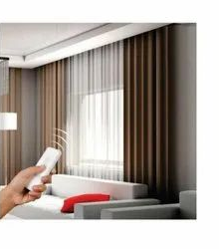
PROBLEM STATEMENT
We have witnessed a rapid inclination towards automation lately. Considering some of the factors such as time consumption, affordability, feasibility and convenience, automation has enhanced our standards of living in numerous ways.

Slide 5
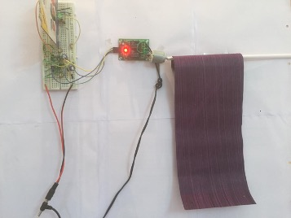
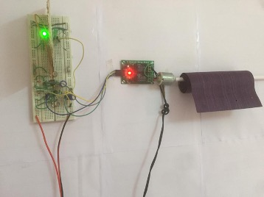
IMPORTANCE
Abiding by this notion, we are presenting an Automatic curtain opener model using LDR. It does the task of folding and unfolding of the curtain as per the light intensity outside the window. It is an automatic process, and the light intensity is sensed by LDR in the circuit.

Slide 6
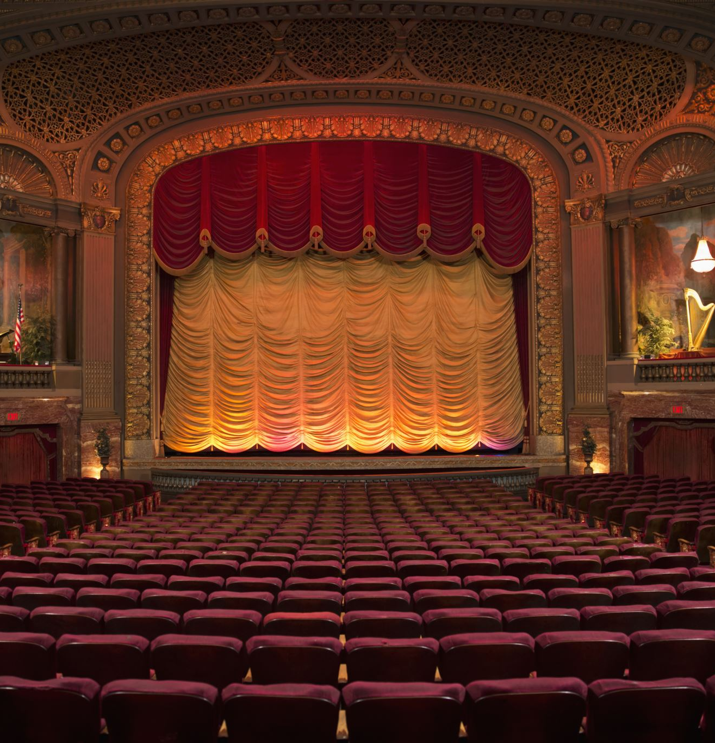
APPLICATIONS
The project profile envisages the production of Automatic Curtain Opener by setting up of unit in a small-scale sector. The Automatic curtain Opener are used for opening and closing of the stage of any good theatre, auditorium conference hall etc.
The mechanism should automatically open and close the curtain depending about the function being performed on the stage. The mechanism consist of single phase induction motor drive a forward-reserve starter and two limit switches.
The motor when actuated the push buttons and contractor may rotate in either direction depending upon the direction of current flowing through its main winding.
The motor once when required to stop required limit switches. In the Automatic Curtain Opener, the motors runs in both the direction for opening and closing hence two numbers of limit switches is required.

Slide 7
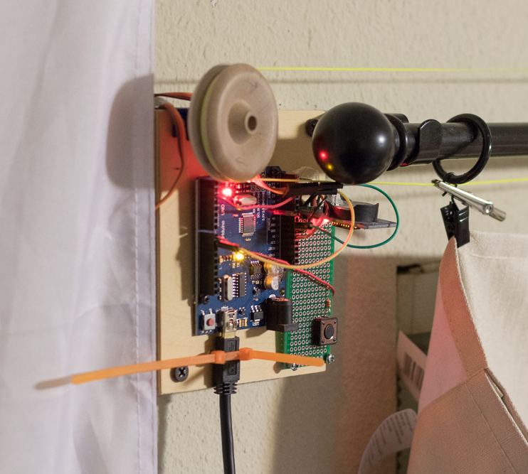
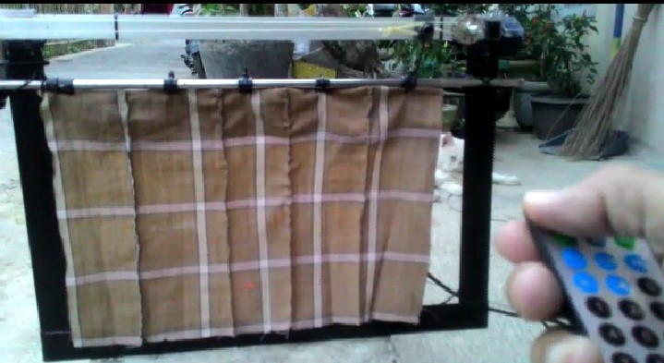
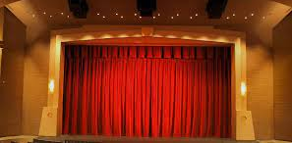
APPLICATIONS

Slide 8
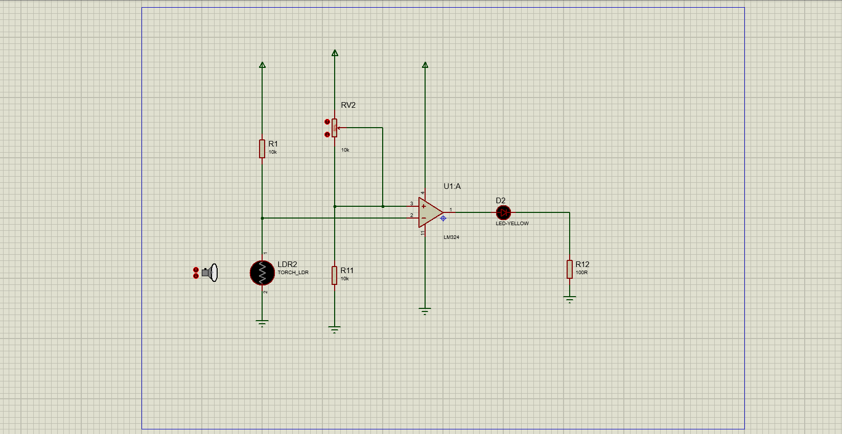

Circuit diagram of project work
Circuit diagram with description about major components

Slide 9

COMPONENTS USED
Light Dependent Resistor (LDR): An LDR is a light sensitive electronic component. The resistance changes with the intensity of light incident on it. Values of the resistance of the LDR ranges over many orders of magnitude. The value of the resistance falls as the level of light increases.

Slide 10
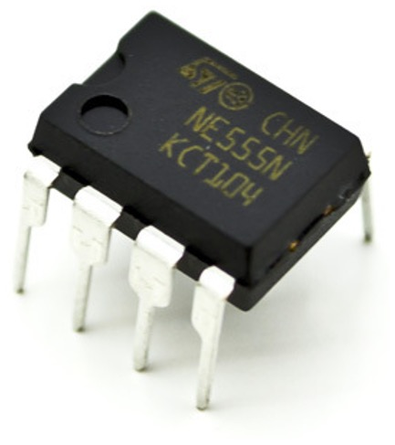
555 timer IC: The 555 timer IC is a precision timing device which can act as either a simple timer to generate single pulses or long-time delays, or as a relaxation oscillator producing a string of stabilized waveforms of varying duty cycles from 50 to 100%. The basic 555 timer gets its name from the fact that there are three internally connected 5kΩ resistors which it uses to generate the two comparators reference voltages

Slide 11
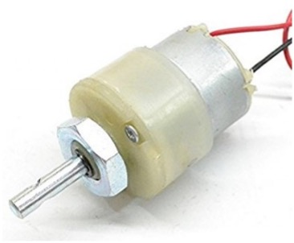
DC Motor:
When a magnetic field and an electric field interact, a mechanical force is produced. The DC motor or direct current motor works on that principle. This is known as motoring action. An electric motor operated by DC (direct current) is known as a DC Motor. A DC motor converts DC electrical energy into mechanical energy.

Slide 12
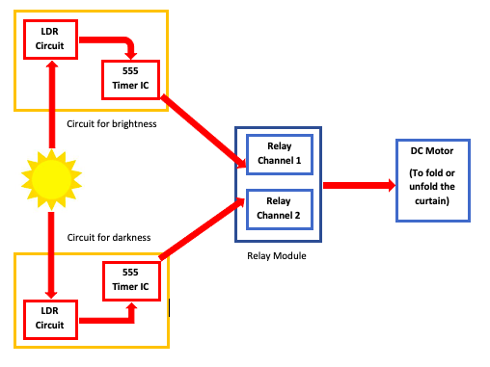
BLOCK DIAGRAM OF PROJECT WORK

Slide 13
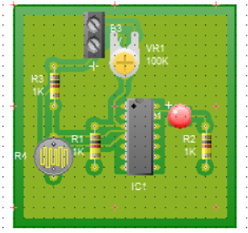
REAL WORLD BOARD OF THE PROJECT

Slide 14
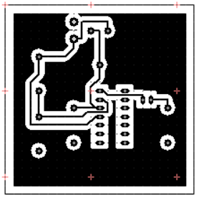
BLOCK DIAGRAM OF THE PROJECT

Slide 15
PROCEDURE
Two separate LDR circuits are used here. One senses the darkness and other one is for light sensing. Deploying two separate circuits, one for sensing the light and the other for the darkness, ensures the proper reversal of rotation of the motor in one of the cases.
The output of the respective LDRs are connected with two timer ICs set with time delays sufficient to fold and unfold the curtain.
Light sensing LDR circuit is inactive when exposed to darkness and vice-versa.
Output of the respective timers reaches the motor via 2 channel relay module.
Motor runs for the time period determined by the delay provided in each of the cases and the curtain moves accordingly.
The time delay for each of the cases can be set by using different values of resistor and capacitor in the timer circuit. Thus, the time delay can be determined using the following formula:
T = 0.69 x R x C

Slide 16
Screenshot of simulation results BEFORE SIMULATION

Slide 17
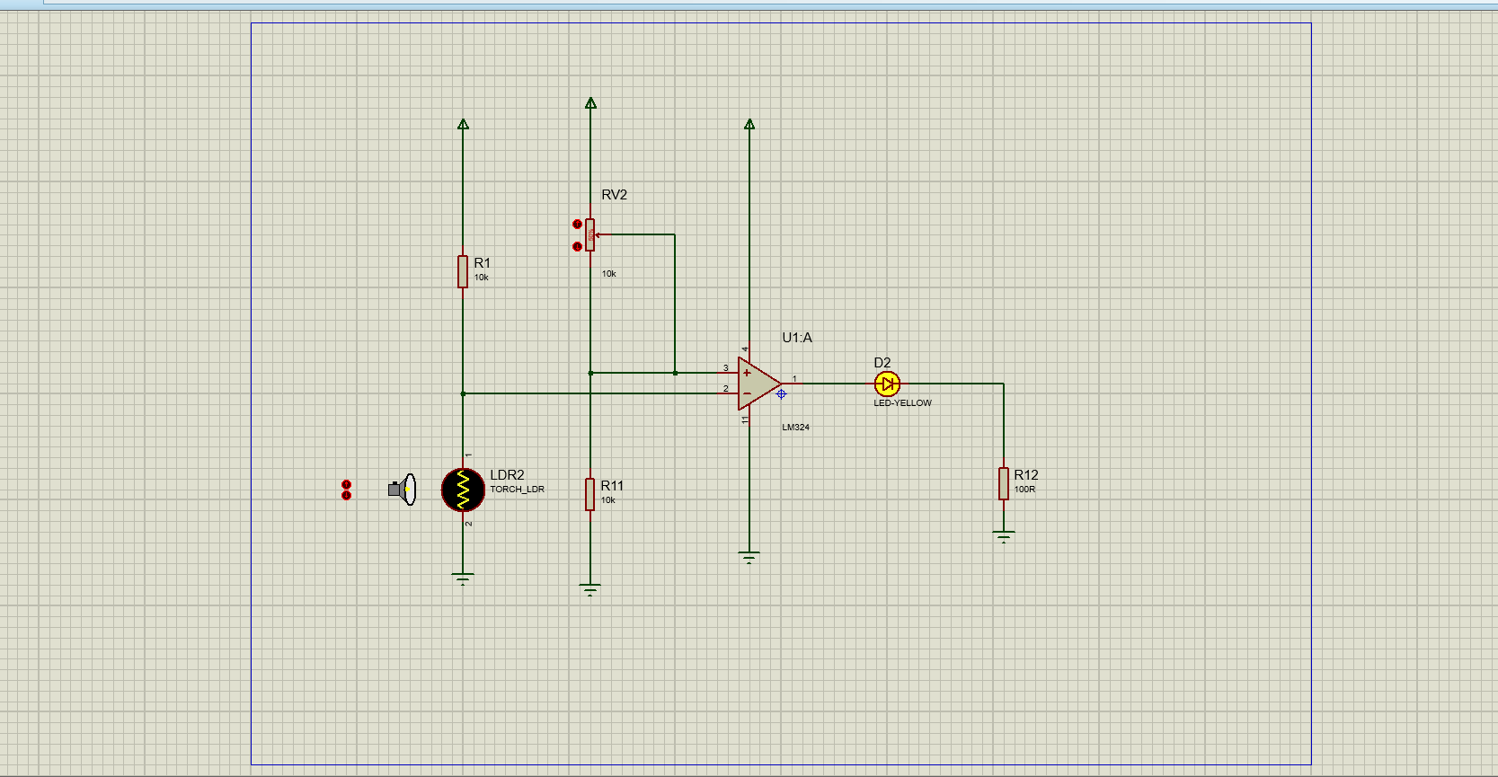
AFTER SIMULATION

Slide 18
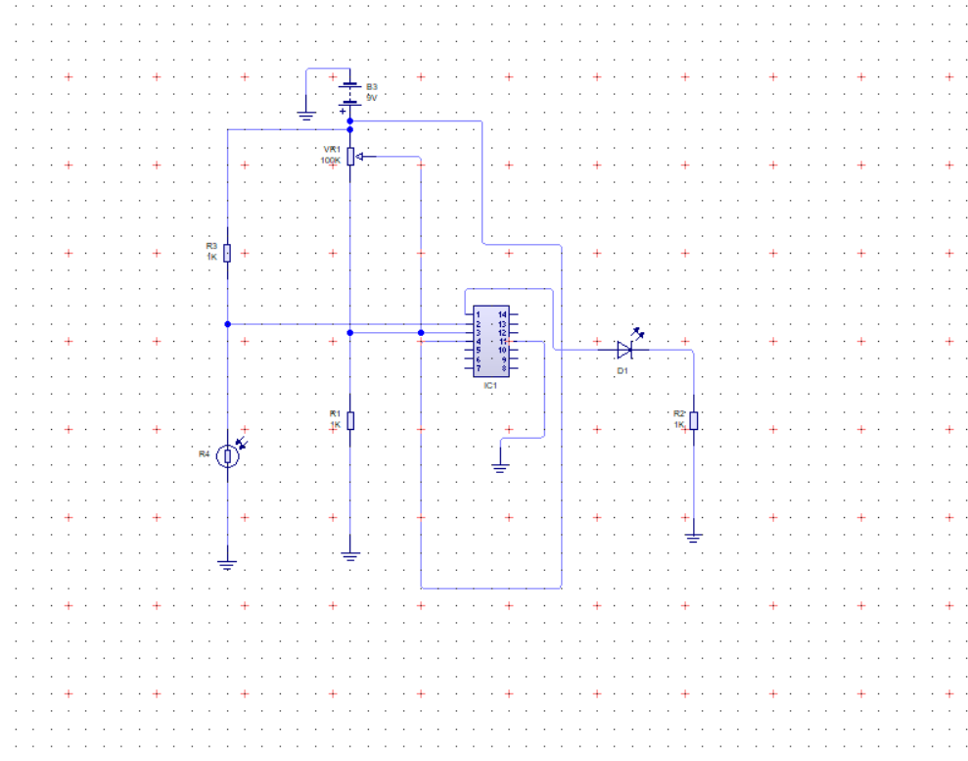
PCB WIZARD

Slide 19
WORK TO BE DONE BEFORE REVIEW 2
Prepare a time plan bar diagram about the things to be done for project work
We need to implement the hardware of the circuit with the hardware components by changing the LED with the curtains

Slide 20
CONCLUSION-LEARNINGS
We have learned about the different components available in proteus and PCB wizard software.
We have learned about the LDR uses and applications
We have learned about how different components are available in different software libraries and how are they extracted to proteus software.

Slide 21
Thank you

